Slide 1
FRAME
User Interview (DIY) FRAME, DISCOVER (Understand, Specify)
Conducted in person or over a phone to collect in-depth information about user needs, experiences, and opinions.
Visual Modeling (DIY) DESIGN (Produce)
Methods used to represent a proposed user interface in visual terms so that alternatives can be evaluated.
DISCOVER
Understand context of use Specify user requirements
Card Sorting (DIY) DISCOVER (Specify), DESIGN
Asking users to group potential content, tools or features is useful for developing information architectures and site navigation.
Applied Cognitive Task Analysis (PRO) DISCOVER (Specify), DESIGN (Evaluate)
Cognitive Task Analysis (CTA) involves the use of a technique or set of methods to identify, describe and determine the cognitive skills, knowledge & strategies needed for the proficient performance of a particular task or set of tasks that are highly covert, dynamic, and involve decision-making & judgement.
DESIGN
Produce design solutions Evaluate (and ultimately validate)
Heuristic Evaluation (DIY, PRO) DESIGN (Evaluate)
One or more reviewers, preferably experts, compare a software, documentation, or hardware product to a list of design principles.
Moderated Usability Tests (PRO) DESIGN (Evaluate)
Usability testing is a method in which representative users are recruited to participate in an evaluation of a system’s user interface to assess the degree to which the system meets usability objectives. These objectives typically relate to the system’s usefulness, efficiency, effectiveness, and user satisfaction.
DELIVER
UI Design Audit (DIY) DESIGN (Evaluate)
Assesses a user interface for compliance to an allocation Style Guide or a UI design guidelines (such as the iOS Human Interface Standards for mobile devices).

Slide 2
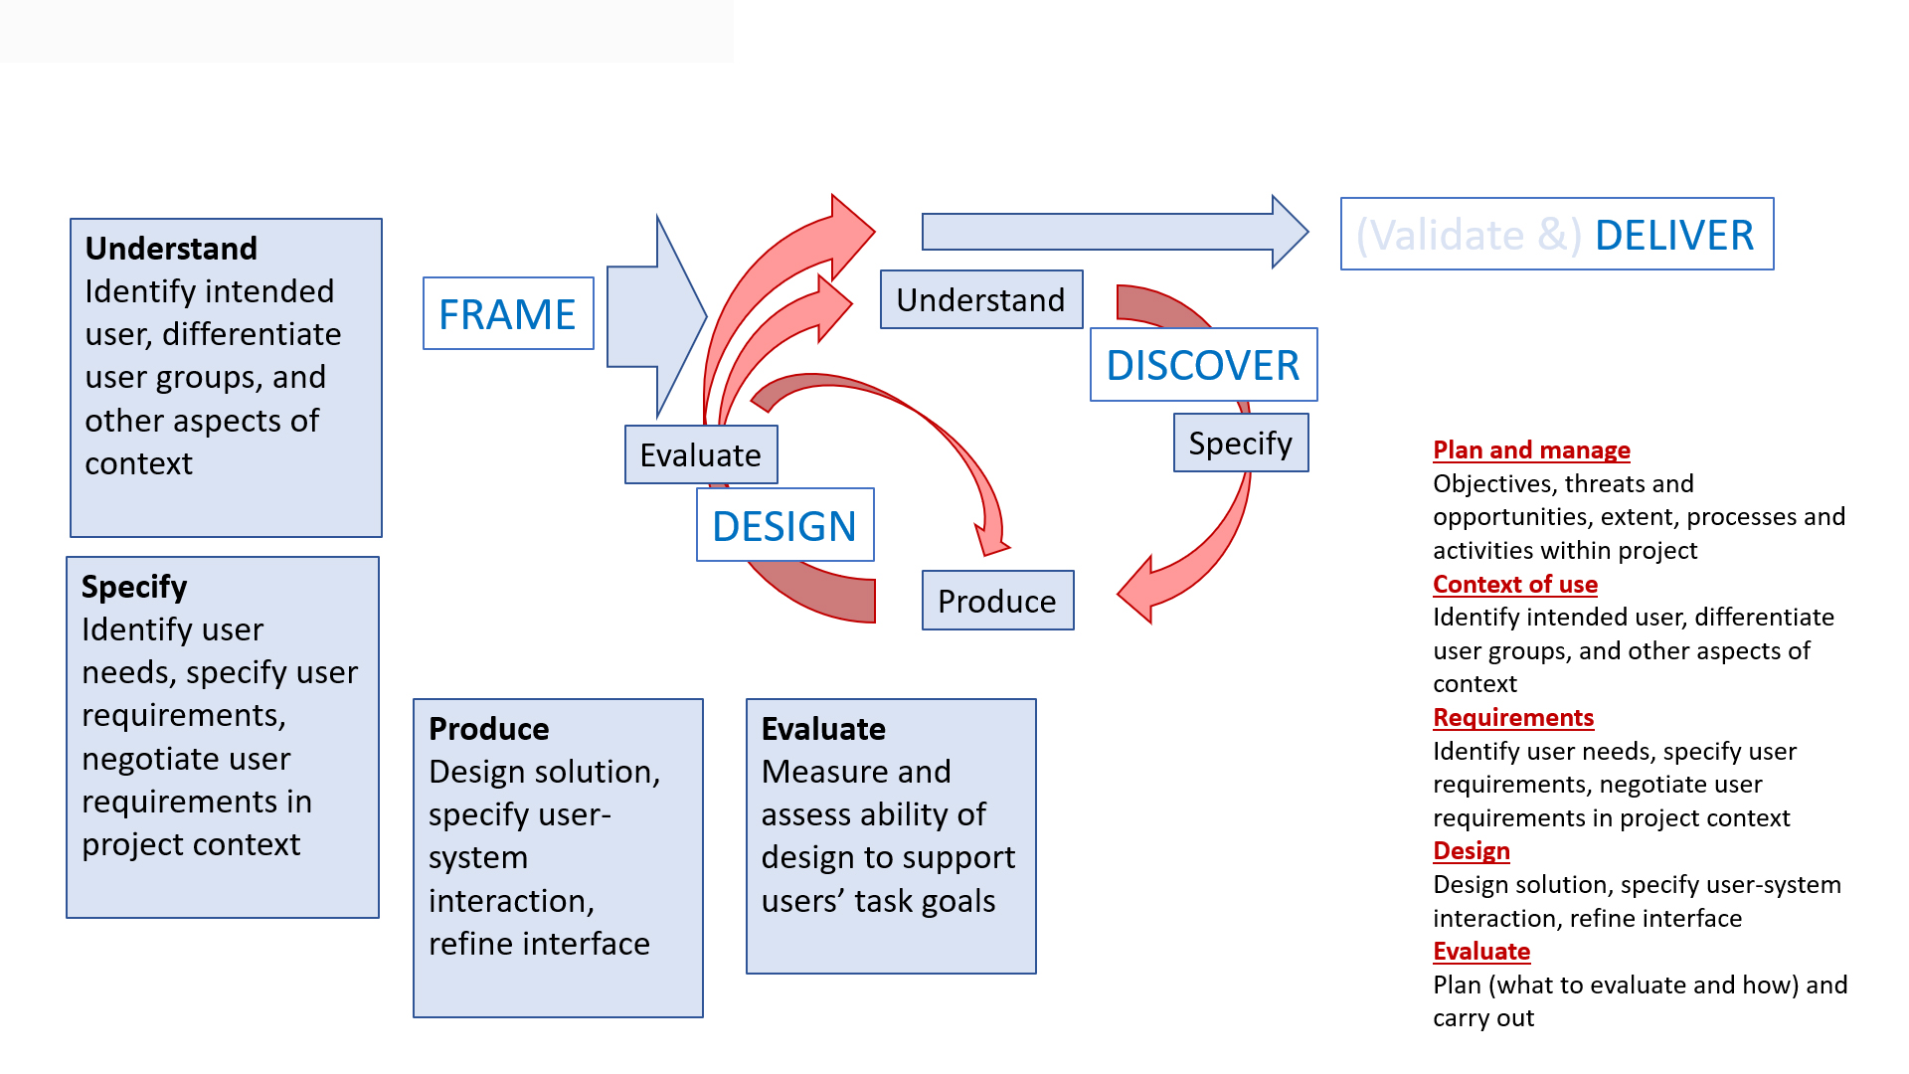
See ISO Process Model.ppt in “UXG Content Related” folder

